Slide 1
UiPath Delegate
If you can prompt it, you can delegate it.

Slide 2
Agenda
1
What Delegate is
The productivity agent you delegate any task to
2
One base, many front doors
Customize it using the same governed base
3
Supercharge your testing
A testing specialist in action. Let the regression run itself
4
The on-ramp: everyday work
Delegate tasks, automate the repetitive work
5
Roadmap and open workstreams
Where Delegate is headed

Slide 3
Your productivity agent
01
UiPath Delegate is the productivity agent you delegate any task to. It acts on your behalf, completing real work end to end, with enterprise governance built in.

Slide 4
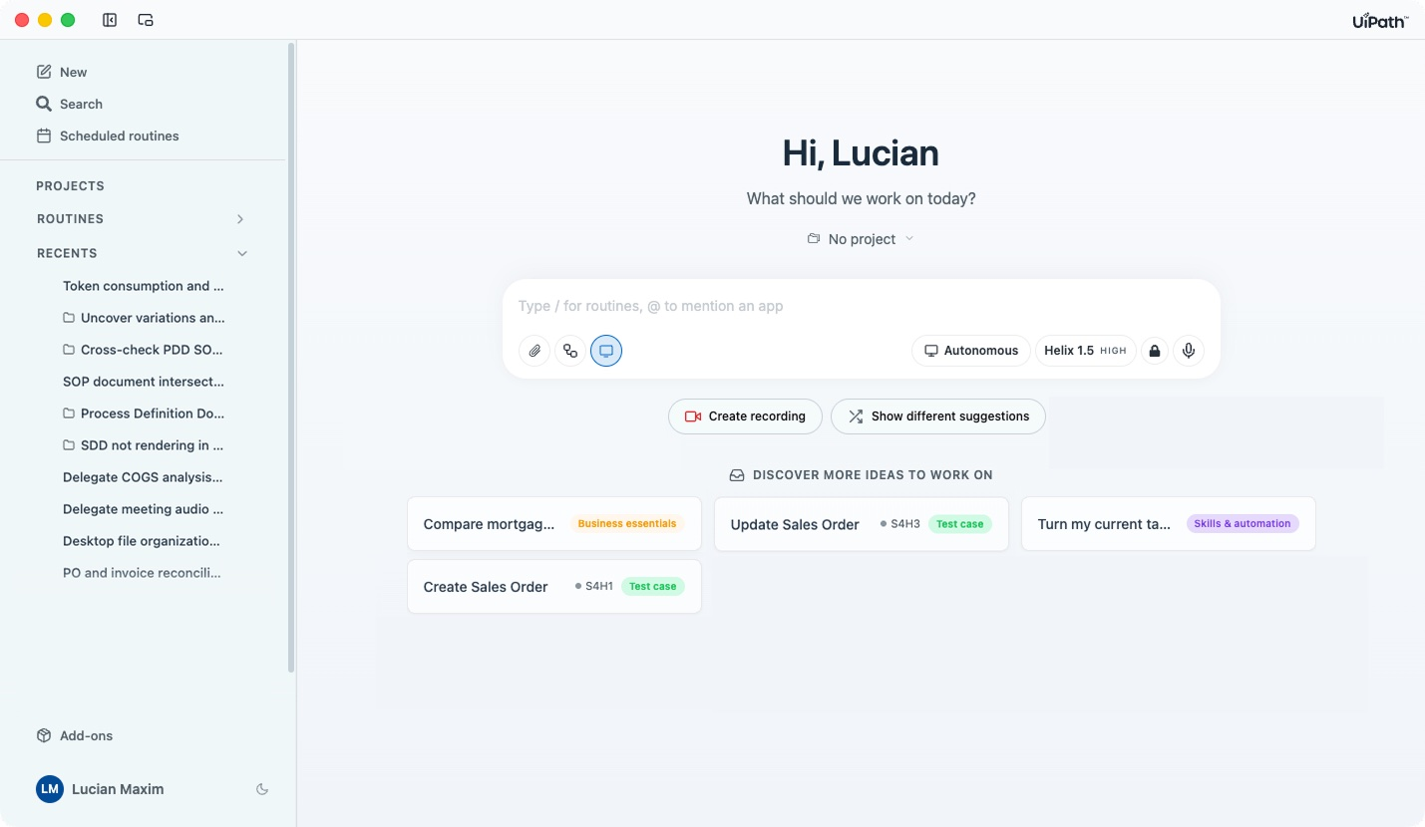

The productivity agent built for the enterprise
MEET UIPATH DELEGATE
It acts under your direction on the real machine and completes work end to end, leaving behind a governed, reusable routine. Model- and system-agnostic, governed by the platform you already trust.
UiPath Delegate
Your productivity agent:
Go beyond suggestions, get tasks completed end to end.
Best-in-class UI automation across browsers and apps.
Delegate with a prompt, voice command, screen recording, or a template.
Reliable, secure, workflow-aware, with out-of-the-box and trainable skills.

Slide 5








Eight reasons the work runs on UiPath
WHY UIPATH
Knows computer use
Access any system
Discovers work
Speaks automation
Runs on your real machine across Windows and macOS in the actual apps, not a sandbox. Leader in RPA.
Pre-authenticated access via Integration Service and MCP, 100+ connectors, so routines reach your systems with no bespoke wiring.
Picks up work from plain language, voice, or recorded demos, however it's easiest to teach. Backed by our Task Capture and Task Mining heritage.
Observed work becomes shareable workflows your whole function re-runs, not a one-off that disappears.
Secure & governed
Model agnostic
System agnostic
You already have it
Sandboxed code execution, a full audit trail, flexible deployment, and a model-agnostic core.
Models drift and get replaced. No reason to stay locked, bring your own subscription or model.
A system of action, not of record, the substrate to automate across any system of record.
A natural evolution of UiPath Assistant. Consumption is included in your user licenses.

Slide 6
Deterministic, or with judgment in the loop
TWO WAYS TO MAKE WORK REPEATABLE
AUTOMATION · PREFER THIS
AGENTIC AUTOMATION
A deterministic script
Keeps a decision in the flow
RPA, API, or code: identical every run.
Repeatable, but a step can reason.
Token-less and fast: no model in the hot path, predictable cost.
Costs tokens and runs slower: the trade for judgment.
More secure: a fixed path, nothing left to open-ended reasoning.
Reach for it only when work must decide as it goes.
or
Deterministic wins
Both are valuable but when it can be deterministic, deterministic wins: token-less, faster, more secure. Reach for judgment only when the work truly needs it.

Slide 7

The 100th person inherits every routine the 99 before built
ROUTINES ARE COMPOUNDED INTEREST
01
02
03
04
Shared, not siloed
No starting over
Reuse improves it
Value per person climbs
Routines go to the Delegate Store: curated, open, and scoped to your organization.
The next person picks up the routine instead of redoing the task from scratch.
Every run is a chance to refine the routine, not repeat the work.
More routines, more reuse. No extra effort, no extra tokens. Adoption compounds.

Slide 8
Why Delegate expands your automation program
BUILT TO EXPAND WHAT YOU RUN
01
02
03
It reaches where your business runs
It taps into automation you already have
It reaches the last mile of automation
Native computer use on Windows and macOS, plus pre-built automations that already drive SAP, Oracle, Citrix, and mainframes.
Reuse your existing automations, queues, assets, and permissions in Orchestrator, your process information in Maestro, and surface human approvals through Action Center. Nothing rebuilt.
It covers the long tail of team work that never justified a full build, delivered far faster than a development cycle.

Slide 9
The known processes and the long tail
BOTH HALVES OF THE WORK, ONE PLATFORM
Automation Program
Delegate Program
LONG TAIL
Best at
Known, high-volume, mission-critical processes, engineered for scale and reliability.
The long tail of team work (prompted or demonstrated) with no development cycle.
How work is built
Designed and deployed by automation teams as durable, governed automations.
Captured from real work by the people doing it, as Automations and Agentic automations.
Governance
One shared identity, audit, approval, and control plane.
The same shared identity, audit, approval, and control plane.
Traditional automation handles the known, high-volume processes; Delegate handles the long tail. Same platform, same governance.

Slide 10




Every agent, under managed identity
THE GOVERNANCE FABRIC DELEGATE RUNS ON
Non-human identities
Trusted vs Protected
Deployment & residency
Human-in-the-loop
Every agent runs under its own managed identity with least-privilege access. No shared or borrowed credentials.
Allow/deny lists govern reach; secrets, keys, and config changes always require explicit approval.
Run in the cloud, on-prem, or on Automation Suite, wherever your data-residency rules require.
Insert approval checkpoints anywhere; run routines supervised or fully unattended, by risk.
Powered by Automation Ops
& the AI Trust Layer
Delegate's LLM usage is subject to AI Trust Layer policies admins configure in Automation Ops, covering third-party model access and audit logging at tenant, group, or user level. Code runs sandboxed, with built-in prompt-injection defenses.

Slide 11
One base, many front doors
02
Customize it for your company. Delegate taps into your data, systems, workflows, apps, and rules, and exposes them to your employees. You decide how you surface it.

Slide 12
Everything you built on UiPath, now in one surface
CONSUMABLE THROUGH DELEGATE
01
02
03
Tap what you already built
Assets become tools
Your company's own assistant
Through MCP, Delegate taps into the Models, Workflows, and Apps your teams already built on the UiPath Platform.
Those assets become tools Delegate can call, No rebuild, no rewiring.
Extend it until it's not a generic agent but your company's own assistant, fluent in your systems and your data.

Slide 13



Make it your own
CUSTOMIZABLE BY DESIGN
Note: this functionality isn’t available in the current scope
A Delegate SDK
Your own front door
The same SDK we use
One substrate
Your developers customize Delegate through an SDK, up to full white-labeling of the surface itself.
Build a dedicated experience for a team, department, business, or vertical.
Cartographer, Delegate for Testing, Autopilot and Process Monitoring are all built on the same SDK
Bring your own models, workflows, apps or MCP tools. Every agent runs under the same identity, audit, and control plane.

Slide 14
A retailer's own assistant
GOLDEN SCENARIO
PERSONA
THE NEED
A marketer at a retailer whose team already runs campaign workflows and analytics models on the UiPath Platform.
Launch campaigns and read their performance without hopping between tools, from the assistant they already work in.
WHAT THEY BUILD
WHY IT LANDS
Existing campaign workflows and analytics models are wired into Delegate through MCP, so the marketer launches a campaign or pulls analytics directly, in plain language.
The assistant is theirs because it's built on their own automations. (Illustrative example, not a deployed customer.)

Slide 15
Delegate as the orchestration layer for vertical agents
RETAIL USE CASE · PRICE DISCOUNT OPTIMIZATION
Purchase orders
Discount optimization
Cross-system data pull
Stakeholder notifications
“Generate POs for low-stock items”
“Push discount prices live for [category]”
“Pull margin & sales for [product line]”
“Notify the buying team discounts are live”
Pulls inventory, applies reorder rules, and drafts POs for supplier review.
Triggers the ML pricing engine, executes the update, and validates it went through.
Queries databases, queues, and records across the vertical's systems of record.
Sends targeted alerts with summary data to stakeholders across channels.
Verticals × Delegate
Delegate × Verticals deliver true enterprise value in a governed way — orchestrating vertical ML, workflows, and systems of record while respecting permissions and compliance.

Slide 16





How teams are using Delegate
IN THE FIELD
Support
GTM (Sales)
Marketing
Professional Services
Finance / FP&A
Plan-my-day triage, end-of-day handoff summaries, and first-response drafting for a team clearing 20–30 cases a day.
A morning command center, pre-call account briefs, and product-specific release memos.
Weekly paid-media optimization, campaign launches, and performance pulls — work that used to go to outside agencies.
Project status roll-ups, delivery checklists, and client-ready reporting from live system data.
Recurring reconciliations, variance pulls, and report preparation across finance systems.

Slide 17
Supercharge your testing
03
Record or execute manual tests, query tests and projects, perform tests locally with computer use, and compile results.Let the regression run itself.

Slide 18
The Tester
A DAY IN THE LIFE
01
02
03
04
Morning — plan the pass
Mid-day — repetitive runs
Afternoon — chase defects
End of day — report
Check overnight regression and the release calendar; decide what to verify.
Re-run regression by hand; fix brittle scripts broken by UI shifts.
Reproduce defects, capture repro steps and screenshots, refresh test data.
Compile the release-readiness report, always a step behind.
THE CHALLENGE
THE OPPORTUNITY
Hand-run regression and brittle scripts drag every release.
A regression routine that adapts instead of breaking.
Every UI shift shatters the suite, maintenance never ends.
End-to-end UI checks run on a schedule or at release time, reproducing defects and refreshing data, every run inside the UiPath governance model.
A full manual pass burns a day the release can't spare.

Slide 19
Regression that adapts instead of breaking
TESTING & QA
PERSONA
THE NEED
QA engineers and testers who hand-run regression suites and maintain brittle UI scripts across web and desktop apps.
Re-run end-to-end regression on every release without burning a day, and without the suite shattering when the UI shifts.
WHAT THEY BUILD
WHY IT LANDS
A routine that runs E2E UI checks across web and desktop, reproduces and logs defects with steps and screenshots, and refreshes test data, on a schedule or at release time.
It adapts when the UI changes instead of breaking like a brittle script. Testing & QA was the first curated external experience on Delegate.

Slide 20
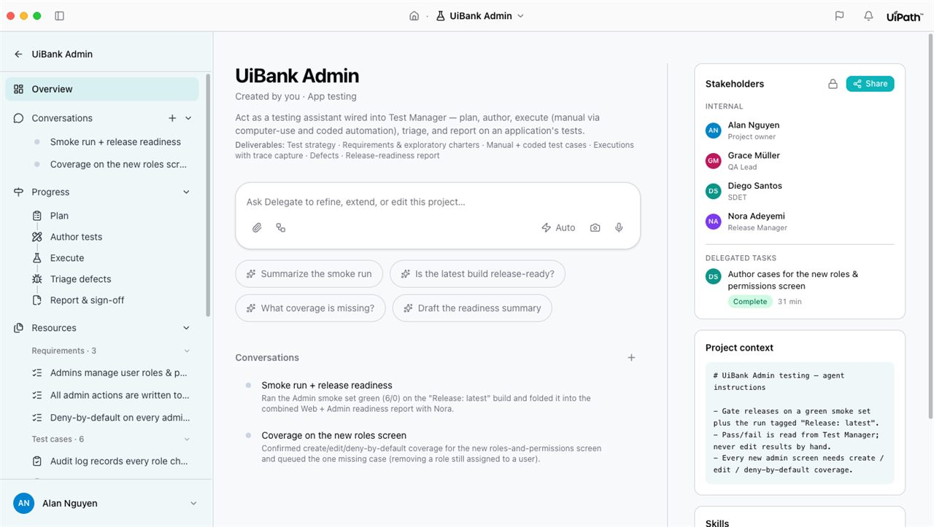
App testing, directly with Delegate
DELEGATE FOR APP TESTING
Delegate — test execution
What you get
Fully integrated with Test Manager.
Run tests locally using computer use and upload results.
Create test reports automatically.

Slide 21
The on-ramp: everyday work
04
Where every user starts: the cross-system work that drains the day. Work that was always too insignificant for an automation program.

Slide 22

Who is the knowledge worker?
THE ENTERPRISE DOER
Core responsibilities & accountability
Process information and move work between systems, ensuring cases and tasks progress to completion.
Mid-level professionals
High-volume, rules-based work, mixed with judgment calls
Accountable for throughput, quality, and SLA adherence, with limited control over tooling and automation resources.
Think: claims adjusters, customer support leads, operations analysts, finance specialists, HR coordinators, sales operations analysts.
The doers who keep the enterprise moving, one case at a time.

Slide 23




Where the day goes
PAIN POINTS & CONSTRAINTS
Time-drain
High cognitive load
Automation gap
Limited resources
2+ hours a day lost on repetitive, low-value tasks: scheduling, copy-paste, exporting reports, filing expenses, basic checks.
Risk of duplicate records, missed escalations, and inconsistent handling. Errors multiply across team members.
Work feels “too small” to be prioritized by central IT. Low perceived ROI means no help arrives.
No access to developers or RPA teams, no time or skills for low-code tools, yet pressure to “do more with less.”

Slide 24
AI ADOPTION BARRIERS & UNMET NEEDS
The line between builder and end user is blurring.
But knowledge workers need a simpler, natural-language way to increase productivity in their day-to-day, without becoming developers.

Slide 25
Enable your employees to delegate their tasks and automate the repetitive work.

Slide 26
A DAY WITH DELEGATE
From a prompt to productivity.
Follow how Delegate transforms Victoria's workday: from the first request to a task completed, end to end.

Slide 27
Meet Victoria
PERSONA
Victoria's key responsibilities
Intake and triage incoming work: claims, tickets, requests, invoices, cases.
Victoria
Collect, validate, and follow up on missing information and evidence.
Claim adjuster at InsureCorp
Resolve escalations, discrepancies, and potential duplicates.
Works in a small team of 5–10 colleagues handling varying daily volumes. Victoria represents knowledge workers across industries who handle similar workflows.
Coordinate with peers and stakeholders via email, chat, and meetings.

Slide 28







A support engineer's day, delegated
SUPPORT USE CASE
Morning planning
Context awareness
License lookup
Troubleshooting research
“Show me my case backlog”
Recognizes the Salesforce case you're viewing: auto-summary, related KB articles, similar past cases.
“Look up license for [customer ID]”
“Pull logs for tenant [X], last 24h”
Delegate pulls assigned cases from Salesforce and helps prioritize the day.
Relevant data returned without switching tools.
Diagnose cloud issues without navigating consoles manually.
Log analysis
First-response drafting
Run predefined jobs
One assistant, all tools
“Find solutions for [error]”
“Draft a first response”
“Run the [job] for [parameters]”
The whole support workflow, driven in plain language from a single surface.
Searches Product Docs, KB, Slack, Confluence, and past cases simultaneously.
Generates a reply from case context to iterate on and send.
Executes predefined operations without leaving the workflow.

Slide 29




Hire your first AI intern
OUT-OF-THE-BOX VALUE
Email digests
CRM updates
Smart reporting
Assets creation
Intelligent summaries delivered daily: the inbox triaged before you open it.
Real-time data synchronization: records kept current without manual entry.
Automated insights and analytics: the numbers, already assembled.
Well-researched, formatted slides, sheets, and docs at your disposal.

Slide 30
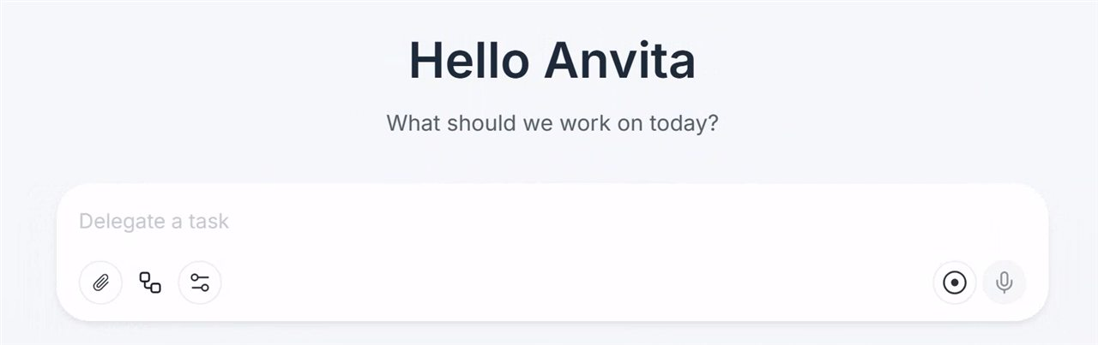
Write it in natural language. No coding.
COMPOSE & EXECUTE TASKS
Delegate — compose a task
How it works
Write plain-language instructions. No coding required.
Delegate breaks complex workflows down into steps.
Handles UI automation, file operations, and API calls.
Learns from your feedback and improves over time.

Slide 31


Capture your expertise as Routines
TEACH NEW SKILLS
Build reusable skills
Share across the team
Create routines that are your custom playbooks.
Make expertise reusable across the whole team.
Document a workflow once, invoke it forever.
Share skills for consistency so everyone runs the same proven steps.

Slide 32
The throwaway task becomes a governed asset
ONE TASK — THEN IT COMPOUNDS
01
02
03
04
Delegate a task
Delegate does it
Save it as a routine
Share it or enhance it
Describe it, say it out loud, or record yourself doing it once.
It acts across web, desktop, files, and your core business systems to complete the task.
The repeatable steps become a workflow anyone can re-run. Same governance either way.
Push it to the team via the Delegate Store, or open it in UiPath Studio for pro-dev hardening.

Slide 33

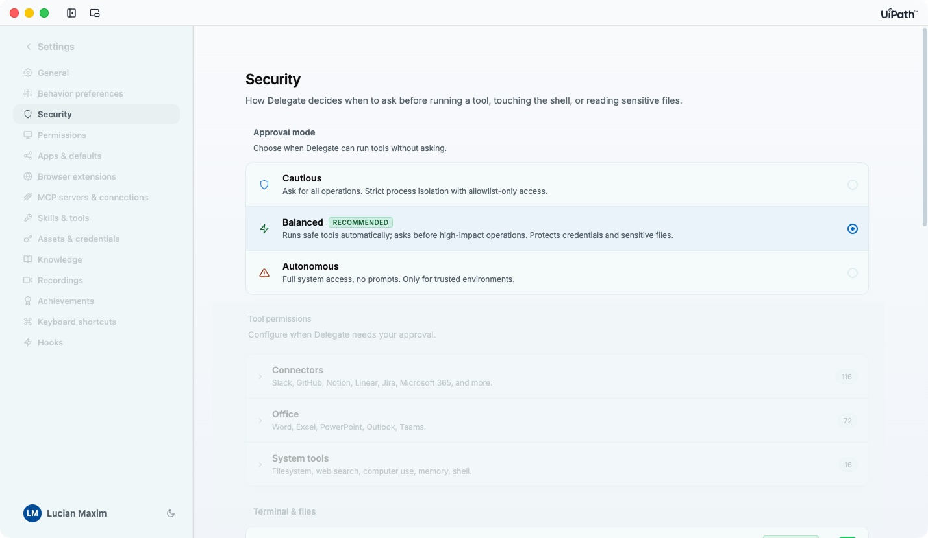


You choose how much autonomy Delegate gets.
SECURITY BY DESIGN
Set the policy globally as a default or adjust it per conversation whenever a task calls for it. Effort is a separate dial: Fast, Moderate, or Ultra-Thinking.
Maximum
Always ask: confirm every action before execution.
Delegate — security settings
RECOMMENDED
Smart
Delegate decides based on risk: auto-runs safe tools, asks on anything sensitive.
Unrestricted
Full autonomy: use only in trusted environments.

Slide 34




Control what Delegate can access
YOUR DATA, YOUR CONTROL
Allow / deny lists
Granular permissions
Full audit trail
Your data stays yours
Govern exactly which apps and URLs Delegate is permitted to reach.
Scope what's allowed by task type. Least privilege, by design.
Every action Delegate takes is logged and reviewable.
Data remains in your control: nothing leaves your environment by default.

Slide 35


You already have it
LICENSING
Nothing to buy
One license per user
Consumption included
Hold user licenses and you already have access. A natural evolution of UiPath Assistant (existing installs auto-update).
Assign the plan that fits the person: Basic, Plus, or Pro.
One consumption pool by plan, included with the license, with overage beyond it.

Slide 36
Roadmap and Open Workstreams
05
Where Delegate is headed

Slide 37
The roadmap, by phase
OPEN WORKSTREAMS
1
Phase 1
2
Phase 2
3
Phase 3
Cartographer
Autopilot
Enablement
BA AGENT
Process Monitoring
App Testing
Discover Use Cases
Productivity
Verticals
Targeted milestones
Aug 2026 Public Preview · 26.10 General Availability (then more personas, one curated release at a time). Dates are targets, subject to change.

Slide 38
THE TAKEAWAY
You don't adopt Delegate.
You just delegate.
Start from a prompt, voice, or recording
The first task pays off. Zero setup
Discover the platform by pulling one real thread

